Slide 1
Q1: Design Patterns, Algorithms and programming language Idioms.
Theory One: MVC Design Pattern
Theory Two: SOLID Principles

Slide 2
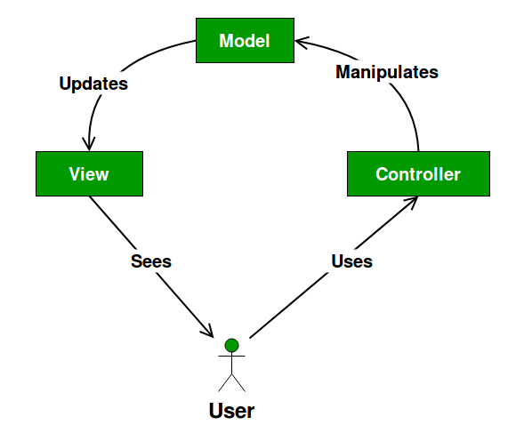
Theory One: MVC Design Pattern
1.1 What is MVC Design Pattern
MVC is also known as Model-View-Controller. It divides the application into three parts that are dependent and connected to each other. (educba.com, n.d.)
Model - controls the logic and rules of application. It doesn’t contain any information on how to show the data to the user. It is independent of the user interface.
View - helps the user to see the model’s data. It is a visualization of information that the application contains.
Controller - provides the support for input and converts the input to commands for the application. It is used between the model and view part.

Slide 3
Theory One: MVC Design Pattern
1.2 Why MVC is a widely accepted theory ？
Today most of the applications follow this pattern. The MVC Design Pattern help in the reusing of code and parallel development. This makes working easier and simpler.
Some of the Top companies that use MVC Design Pattern are –
Microsoft
Go Daddy
Dell
Visual Studio
Wild Tangent
Ref : https://www.educba.com/what-is-mvc-design-pattern/

Slide 4
Theory One: MVC Design Pattern
1.3 What I Have Done ?
The sudoku game I designed used the MVC Design Pattern.
Model - Model included the main logic and algorithm of the game. The Model includes the functions of reading game information from CSV documents, transforming the game information into data types that can be displayed by the user interface, designing methods to obtain the value of sudoku games, designing methods to change the value of games, judging whether the games are completed and so on.
View - WinForms is used to display the game interface in Sudoku game. It inherits from IView and Form and plays the role of View in MVC structure. The main function of the WinForms is display the gameboard, inputs information to program and outputs information to user.
Controller - Controller is the control center of the whole program. It is like a bridge between View and Model to connect the whole program.

Slide 5
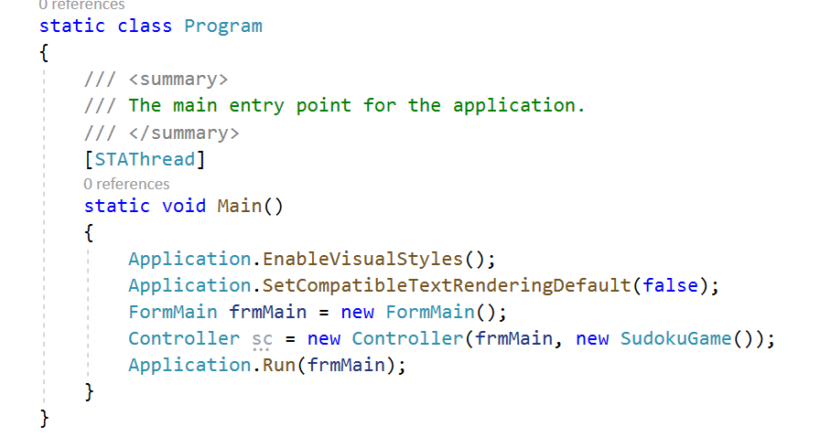
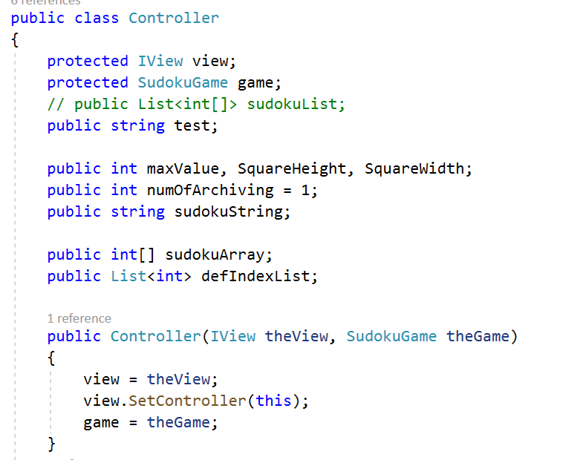
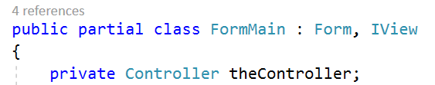
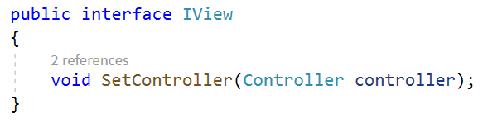
Theory One: MVC Design Pattern
1.4 Code Example

Slide 6
Theory One: MVC Design Pattern
1.5 Compare and Contrast
Compare with other possible approaches, this project use MVC has several advantages:
High reusability of code. Because the model is independent of the view interface, we can migrate a model to a new platform independently. All we need to do is make changes to the view and controller on the new platform.
High code maintainability. If we need to add and remove game functions, we only need to make changes in the model instead of making more changes to the view interface. If we need to improve the game interface, we only need to modify view. This greatly improves the efficiency of program development.
Shorten program development time. Using MVC mode in large development projects is conducive to the division of work of multiple developers and the improvement of development efficiency.
Disadvantage of MVC:
Using MVC in the development of small projects greatly increases the difficulty of development.

Slide 7
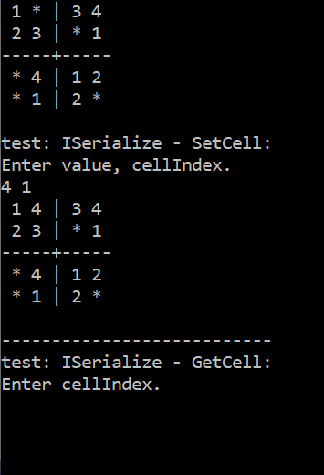
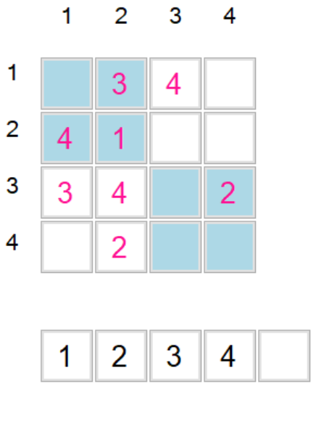
Theory One: MVC Design Pattern
1.6 The Effectiveness of My Approach
(Text-only interface)
(GUI interface)
Because the MVC is used in the development of the game, when the user changes the requirements of the game interface, the programmer can be quickly grafted from one interface to another without rewriting the entire game.
In practice, we reused the model, rewrite the user interface, and modify the whole program with a little adjustment to the controller.

Slide 8
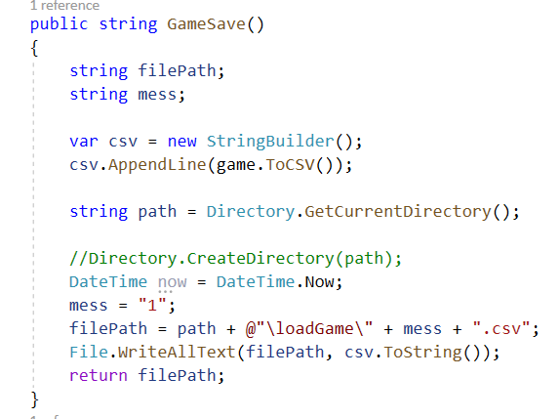
Theory One: MVC Design Pattern
1.7 How Could I Improve?
In the existing software code, there are still some functions that can not be clearly defined, so some program logic is written into controller. In the later stage, I hope to make the function of each method more clear.
For example:

Slide 9
Theory Two: SOLID Principles
2.1 What is SOLID Principles
SOLID Principles is a coding standard that all developers should have a clear concept for developing software in a proper way to avoid a bad design. It was promoted by Robert C Martin and is used across the object-oriented design spectrum. When applied properly it makes your code more extendable, logical and easier to read.
S - Single Responsibility Principle :A class should have one, and only one, reason to change.
One class should only serve one purpose, this does not imply that each class should have only one method but they should all relate directly to the responsibility of the class. All the methods and properties should all work towards the same goal. When a class serves multiple purposes or responsibility then it should be made into a new class.
O - Open-closed Principle : Entities should be open for extension, but closed for modification.
Software entities (classes, modules, functions, etc.) be extendable without actually changing the contents of the class you’re extending. If we could follow this principle strongly enough, it is possible to then modify the behavior of our code without ever touching a piece of original code.

Slide 10
Theory Two: SOLID Principles
2.1 What is SOLID Principles
L - Liskov Substitution Principle : Subclass/derived class should be substitutable for their base/parent class.
It states that any implementation of an abstraction (interface) should be substitutable in any place that the abstraction is accepted. Basically, it takes care that while coding using interfaces in our code, we not only have a contract of input that the interface receives but also the output returned by different Classes implementing that interface; they should be of the same type.
I - Interface Segregation Principle : A Client should not be forced to implement an interface that it doesn’t use.
This rule means that we should break our interfaces in many smaller ones, so they better satisfy the exact needs of our clients.
Similar to the Single Responsibility Principle, the goal of the Interface Segregation Principle is to minimize the side consequences and repetition by dividing the software into multiple, independent parts.
D - Dependency Inversion Principle : High-level modules should not depend on low-level modules. Both should depend on abstractions. Abstractions should not depend on details. Details should depend on abstractions.
By applying the Dependency Inversion the modules can be easily changed by other modules just changing the dependency module and High-level module will not be affected by any changes to the Low-level module.

Slide 11
Theory Two: SOLID Principles
2.2 Why MVC is a widely accepted theory ？
Ref : https://hackernoon.com/solid-principles-simple-and-easy-explanation-f57d86c47a7f
https://www.baeldung.com/solid-principles

Slide 12
Theory Two: SOLID Principles
2.3 What I Have Done ?
In my project, my code follow the Single Responsibility Principle. There. Class “Controller” is used to control the whole game. Class “SudokuGame” is used to store the main logic of the game. Class “ FormMain” is used to display the game.
We also follow the Interface Segregation Principle. This game have 5 separate Interface.
IGame for initialization purposes
IGet whare three main classic retrieves a cell value from a game board in various ways
ISet which sets a cell value into a game board in various ways
ISerialize which reads/writes values for a whole game board and implies knowledge of the way the data is stored, wither in CSV or in an appropriate class.
IView for the whole game display.

Slide 13
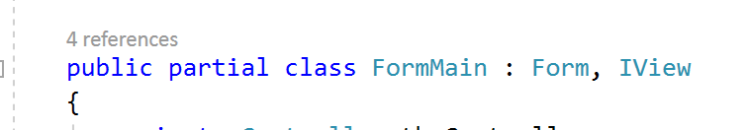
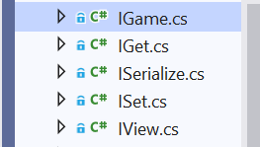
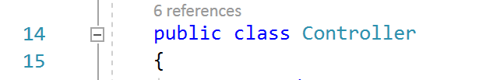
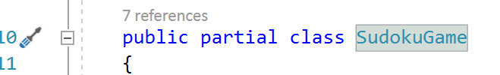
Theory Two: SOLID Principles
2.4 Code Example
Three main class:
Five separate Interface:

Slide 14
Theory Two: SOLID Principles
2.5 The Effectiveness of My Approach
Following the single responsibility principle makes my testing easier. With a single responsibility, the class will have fewer test cases. Less functionality also means less dependence on other classes. It leads to better code organization because smaller and more purposeful classes are easier to search.
Following the Interface Segregation Principle can make my program logic clearer and function implementation more flexible.

Slide 15
Q2: Use appropriate software life-cycle models and software construction steps.
Theory One: Prototyping Model of Software Life-cycle

Slide 16
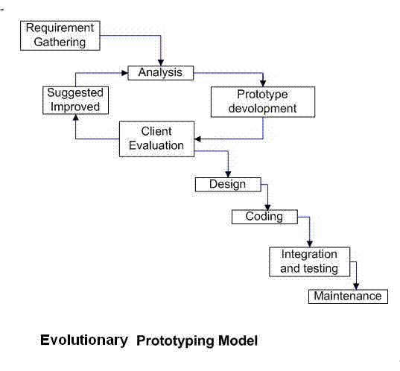
Theory One: Prototyping Model
2.1 What is Prototyping Model
The prototyping model is a systems development method in which a prototype is built, tested and then reworked as necessary until an acceptable outcome is achieved from which the complete system or product can be developed.
This model works best in scenarios where not all of the project requirements are known in detail ahead of time. It is an iterative, trial-and-error process that takes place between the developers and the users.
In the development of this game, we mainly used Evolutionary prototyping model .

Slide 17
Theory One: Prototyping Model
2.2 Why Prototyping Model is a widely accepted theory ？
Prototyping Model can solve the most urgent needs of users in a short time and complete a demonstrable product. This product is only part of the implementation (most important). Its most important purpose is to determine the real needs of users.
This method can obtain the user's requirements effectively in the actual development, so it is widely used in the process of software development.
Ref : https://searchcio.techtarget.com/definition/Prototyping-Model
https://melsatar.blog/2012/03/15/software-development-life-cycle-models-and-methodologies/

Slide 18
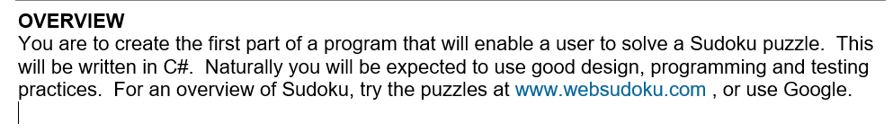
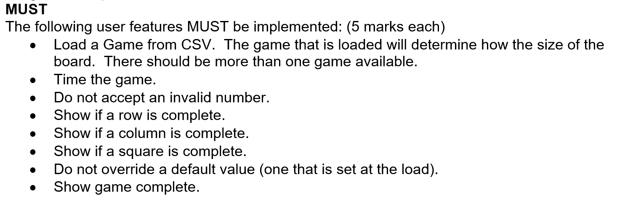
Theory One: Prototyping Model
2.3 What I Have Done ?
1. In the first stage of developing the program, the user’s requirement is to create a Sudoku game with C#. According to the requirement, we designed most of the logic of the game, and show it to users through the console interface.
2. In the last stage of the game development, the user give us some more detailed requirements, including the GUI interface of the game, the specific game functions they want to have, etc. After obtaining the precise needs of users, we continue to develop the game software.

Slide 19
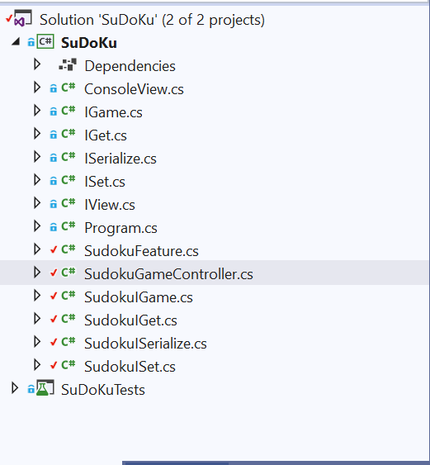
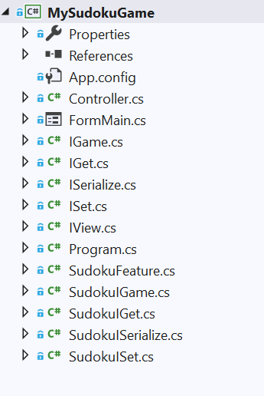
Theory One: Prototyping Model
2.4 Code Example
First version of the program
Second version of the program
Improved according to user requirements

Slide 20
Theory One: Prototyping Model
2.5 Compare and Contrast
Compare with other possible approaches, prototyping model has several advantages:
1. Reduced time and costs, but this can be a disadvantage if the developer loses time in developing the prototypes.
2. Improved and increased user involvement.
Disadvantage of prototyping model :
1. Insufficient analysis. User confusion of prototype and finished system.
2. Developer misunderstanding of user objectives.
3. Excessive development time of the prototype.
4. It is costly to implement the prototypes.

Slide 21
Theory One: Prototyping Model
2.6 The effectiveness of my approach
If the game is developed according to the waterfall model, the game development results may not meet the real needs of users, or we will spend more time to revise the original game program.
2.7 How I Improved ?
In fact, we use MVC structure to develop game software, which solves the possible defects of prototyping model. It can not only quickly submit the prototype to the user, but also reduce the cost of modifying the program.

Slide 22
Q3: Design programs.
Theory One: Structural UML diagrams
Theory Two: Behavioral UML diagrams

Slide 23
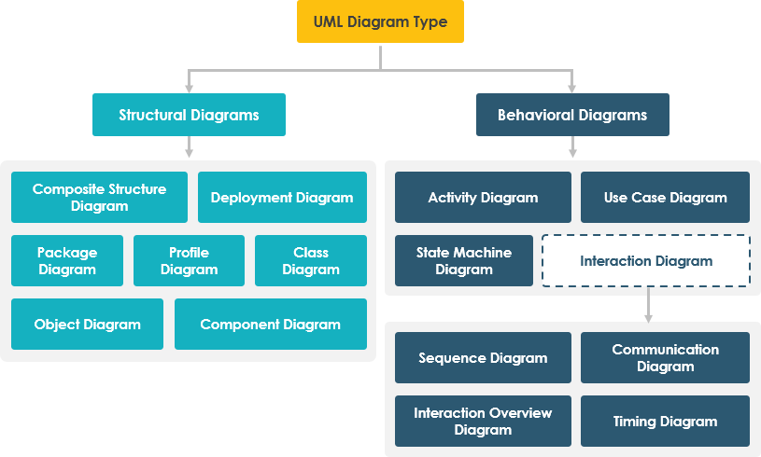
Theory One: Structural UML diagrams
3.1.1 What is Structural UML diagrams ?
3.1.2 What I have done ?
Theory Two: Behavioral UML diagrams
3.2.1 What is Behavioral UML diagrams ?
3.2.2 What I have done ?
Summary: Structural UML diagrams & Behavioral UML diagrams
3.3.1 Compare and contrast
3.3.2 The effectiveness of my approach
3.3.3 How I improved?

Slide 24
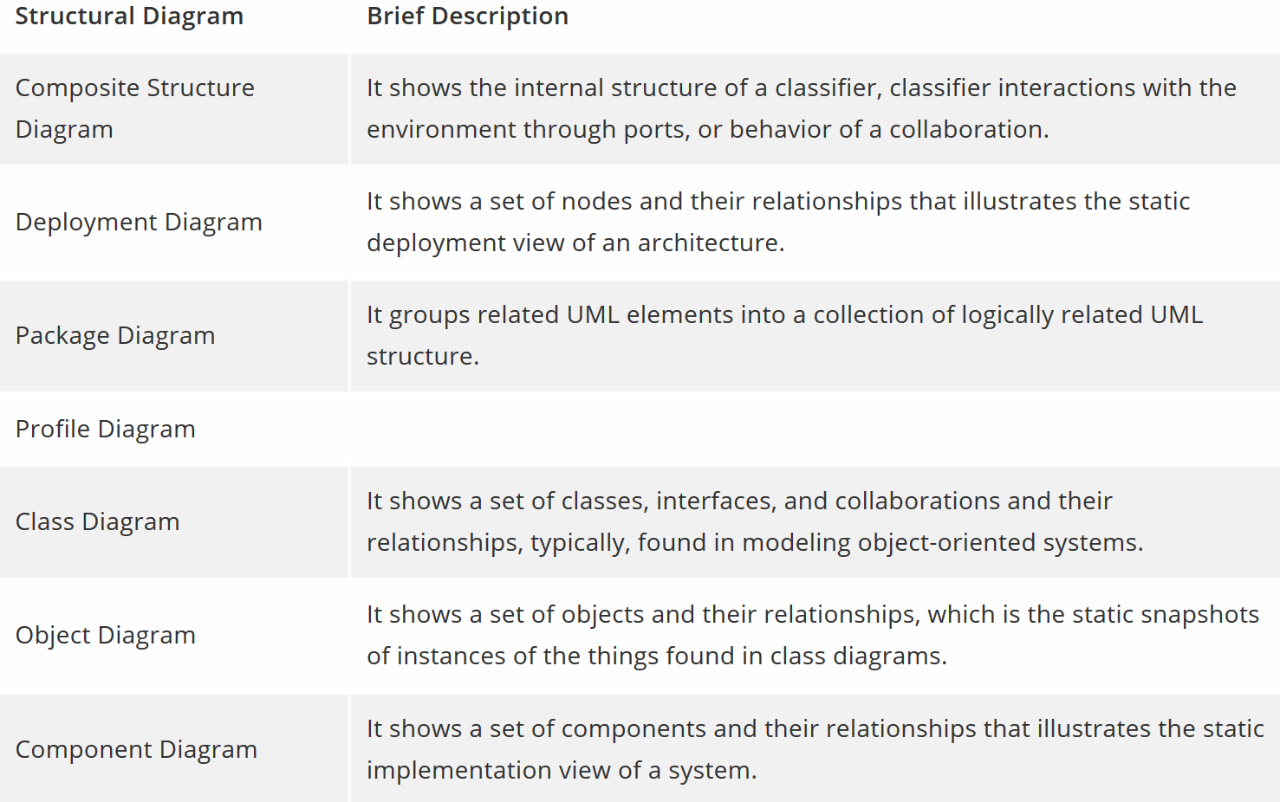
Theory One: Structural UML diagrams
3.1.1 What is Structural UML diagrams ?
The structural diagrams represent the static aspect of the system. These static aspects represent those parts of a diagram, which forms the main structure and are therefore stable.
These static parts are represented by classes, interfaces, objects, components, and nodes.
In this program, we mainly used Class diagram.
Types of structural diagrams
Ref: https://www.tutorialspoint.com/uml/uml_standard_diagrams.htm
https://www.smartdraw.com/uml-diagram/
https://www.visual-paradigm.com/guide/uml-unified-modeling-language/behavior-vs-structural-diagram/

Slide 25
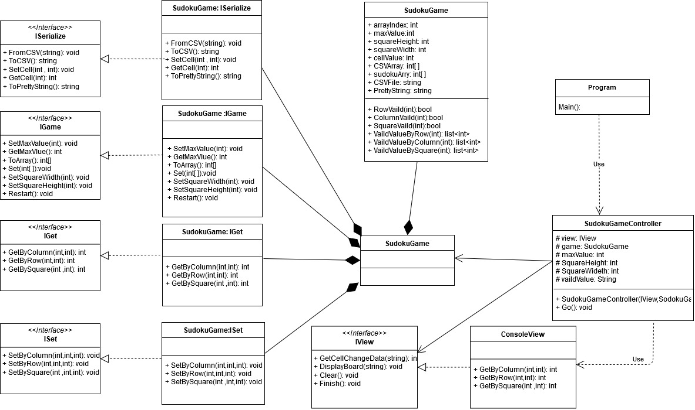
Theory One: Structural UML diagrams
3.1.2 What I Have Done ?
I made this class diagram for my first version of the game program.

Slide 26
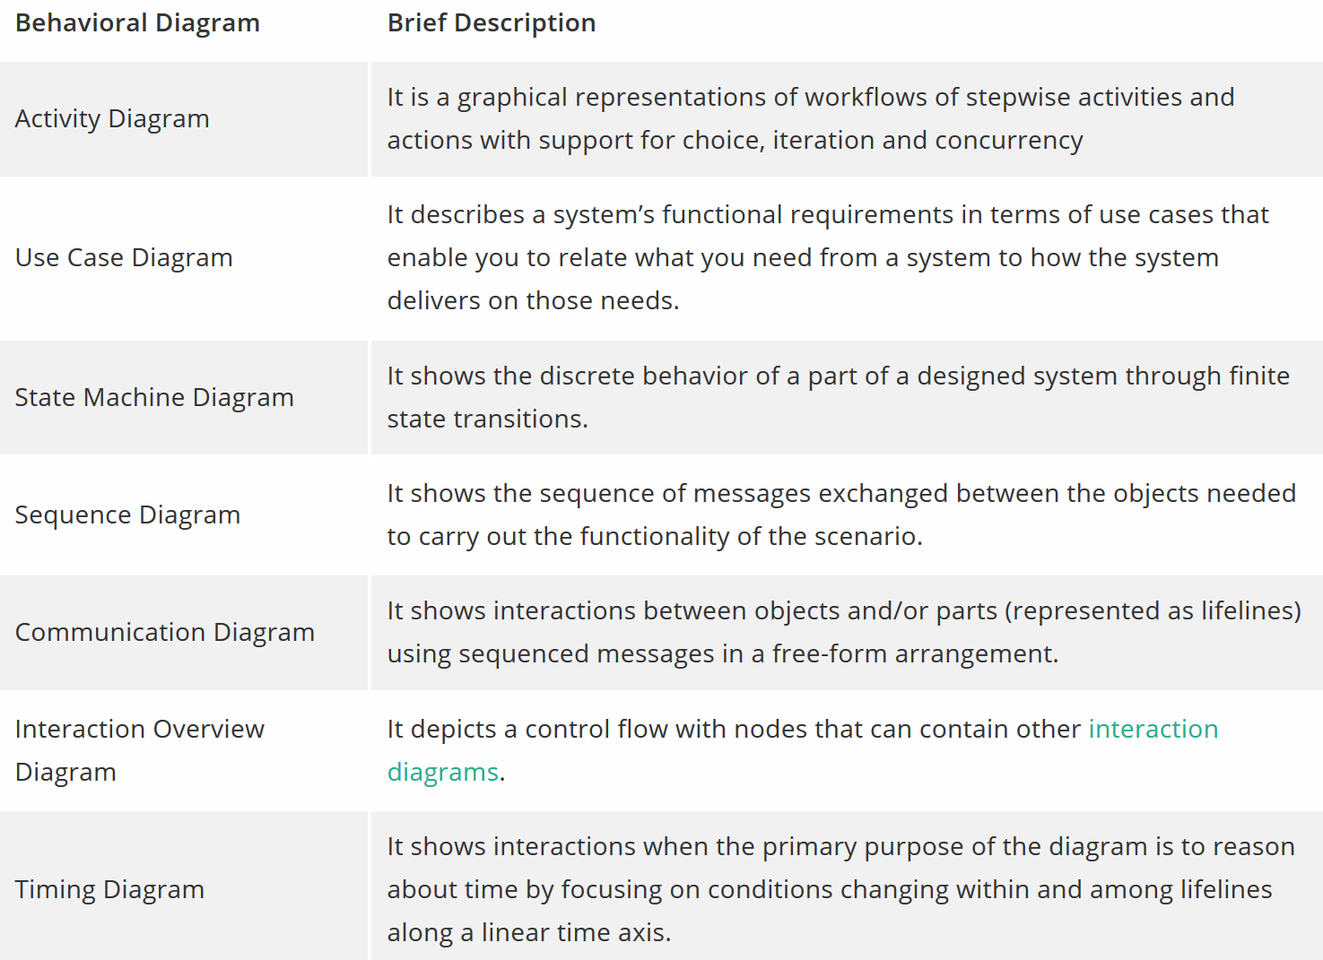
Theory Two: Behavioral UML diagrams
3.2.1 What is Behavioral UML diagrams ?
Any system can have two aspects, static and dynamic. So, a model is considered as complete when both the aspects are fully covered.
Behavioral diagrams basically capture the dynamic aspect of a system. Dynamic aspect can be further described as the changing/moving parts of a system.
In this program, we mainly Sequence Diagram , Activity Diagram , Use Case, Structure Diagram
Types of behavioral diagrams
Ref: https://www.tutorialspoint.com/uml/uml_standard_diagrams.htm
https://www.smartdraw.com/uml-diagram/
https://www.visual-paradigm.com/guide/uml-unified-modeling-language/behavior-vs-structural-diagram/

Slide 27
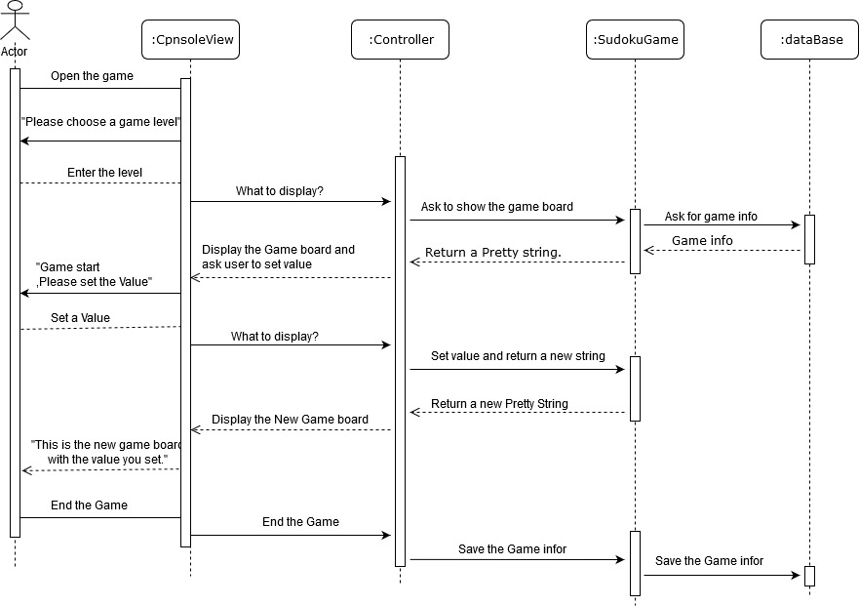
Theory Two: Behavioral UML diagrams
3.2.2 What I Have Done ?
When I design the game , I use Behavioral diagrams to design the running process of the game.

Slide 28

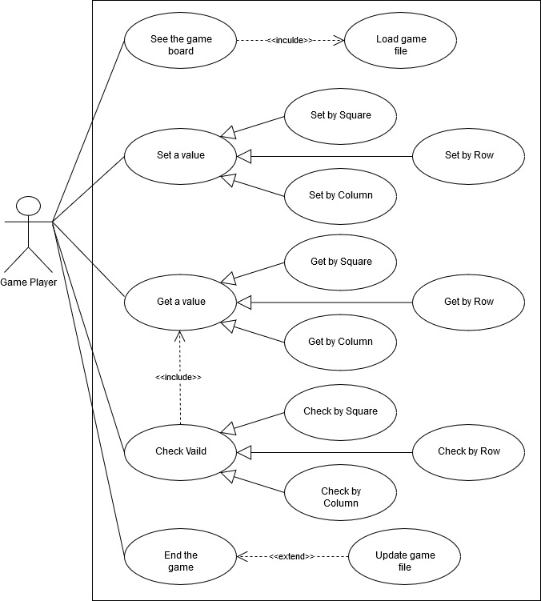
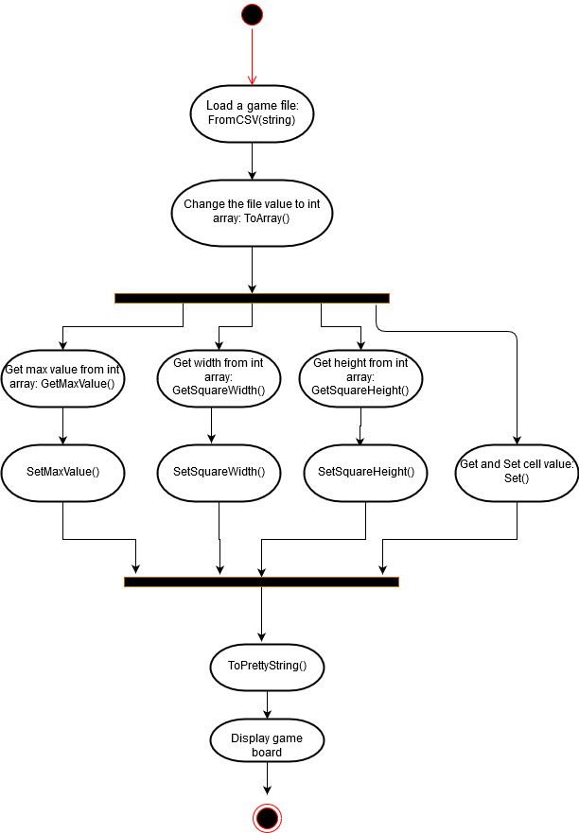

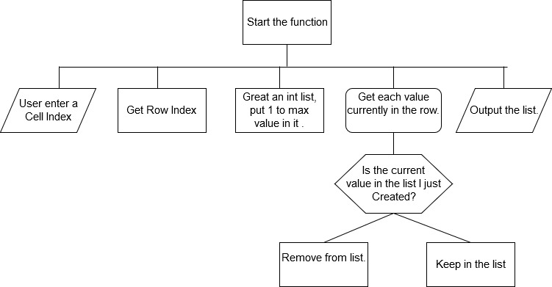
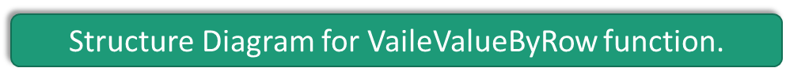
Theory Two: Behavioral UML diagrams
The example of how I use the Behavioral diagrams.

Slide 29
Summary: Structural UML diagrams & Behavioral UML diagrams
3.3.1 Compare and contrast
Behavioral diagram shows how the system works ‘in motion’, that is how the system interacts with external entities and users, how it responds to input or event and what constraints it operates under.
Structure diagrams depict the static structure of the elements in your system. i.e., how one object relates to another. It shows the things in the system – classes, objects, packages or modules, physical nodes, components, and interfaces.

Slide 30
Summary: Structural UML diagrams & Behavioral UML diagrams
3.3.2 The effectiveness of my approach
Using Structural UML diagrams in the design phase gives me a more detailed and comprehensive understanding of the structure of the program. So that I can clearly understand the relationship between classes in the later code stage.
Using Behavioral UML diagrams can help me sort out the process of clear program, which is very helpful for the design of game process and specific game functions.
3.3.3 How I improved?

Slide 31
Q4. Design user interfaces which conform to recognised usability criteria.
Theory One: Visibility of system status.
4.1 What is Visibility of system status?
4.2 What I have done ?
4.3 Scan of design.
4.4 Theoretical summary
4.5 How could I improved.
#3: User control and freedom
Users often choose system functions by mistake and will need a clearly marked "emergency exit" to leave the unwanted state without having to go through an extended dialogue. Support undo and redo.

Slide 32
Q4. Design user interfaces
Theory One: Visibility of system status.

Slide 33
Theory One: Visibility of system status
4.1 What is Visibility of system status
The visibility of system status refers to how well the state of the system is conveyed to its users. Ideally, systems should always keep users informed about what is going on, through appropriate feedback within reasonable time.
The ways to meet this standard are including let user to know the current system status, show appropriate feedback for a user action, Compel Users to Action, and so on.
The visibility of system status is a basic tenet of great user experience. At its core, this heuristic encourages open and continuous communication, which is fundamental to all relationships — whether with people or devices. Users who are uninformed about the system’s current status cannot decide what to do next in order to accomplish their goals, nor can they figure out if their actions were effective or if they made a mistake.
Ref : https://www.nngroup.com/articles/visibility-system-status/

Slide 34
Theory One: Visibility of system status
4.2 What I have done ?
I designed two navigation of the game, top and side menu, to adapt to users' different operation habits. Navigation bar keys clear indication, will not cause user ambiguity.
I designed different color Numbers to represent the default value of the game and the value that users can modify, so that users can easily understand the game information.
In the process of the game, I changed the color of the background and Numbers of the game to timely report the progress of the game to the users.
When the game is paused, the hidden board forces the user to click the button again to start the game.
When the game is over, the game interface is hidden and the victory message appears.

Slide 35
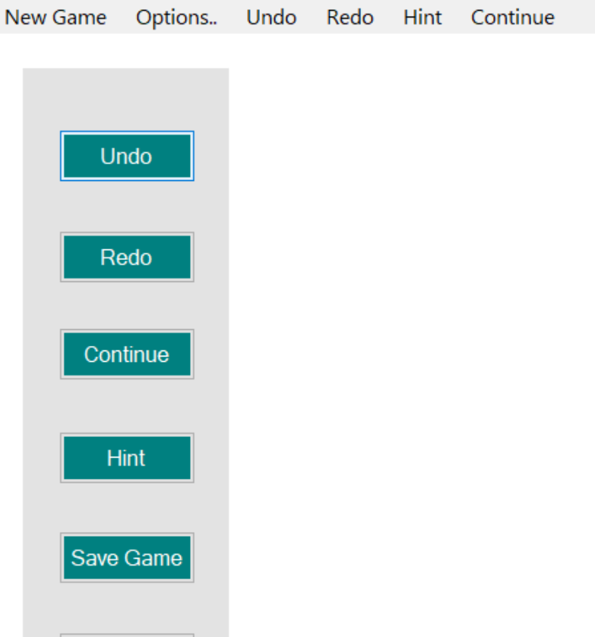
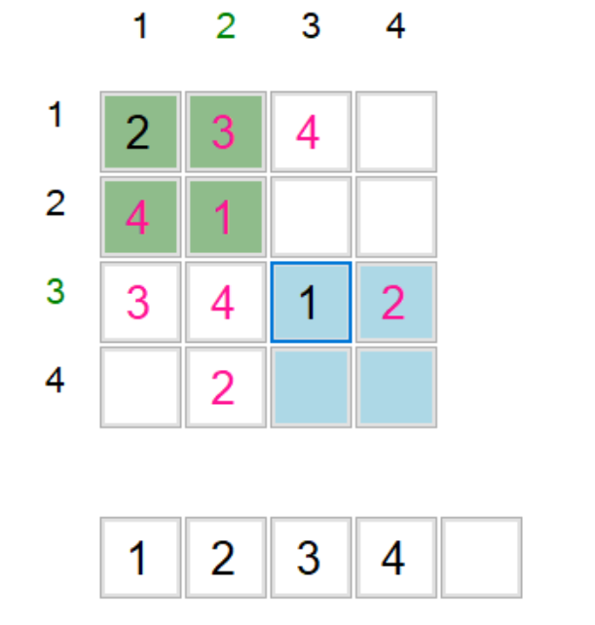
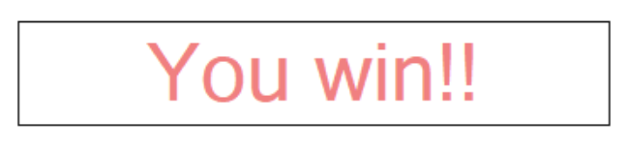
Theory One: Visibility of system status
4.3 Scan of design
Green numbers and areas are used to show valid row, col and square.
When the game is paused, the game time stops, the button’s text change to “continue”, and the game board is hidden. To start the game, the user must click the button again
The pink number represents the unmodifiable game default number, the black number represents the number that users can change it.
When the game is over, the game interface is hidden and the victory message appears..

Slide 36
Theory One: Visibility of system status
4.4 Theoretical summary
Compared with other possible approaches, designing a game user interface based on this theory allows users to have a clearer understanding of the state of the game.
The navigation bar is designed to allow users to quickly understand what the game has to offer. Without a status bar, users might be confused about how to play the game.
During the game, changing the color to show the effective area is more effective and intuitive than text output.
In addition, the state of the game in the pause and victory display, can let the user know the state of the game.
4.5 How could I improve.
In the next stage of game production, I will design more status tips to the user. Including game tips, score display, etc.

Slide 37
Q5. Code programs in the specified language using the prescribed standards.
Theory One: Naming Conventions
Theory Two: Commenting Conventions

Slide 38
Theory One: Naming Conventions
5.1.1 What is Naming Conventions?
Naming Conventions is a set of rules for choosing the character sequence to be used for identifiers which denote variables, types, functions, and other entities in source code and documentation. It relate to word choice, guidelines on using abbreviations and acronyms, and recommendations on how to avoid using language-specific names.
It is general including :Word Choice, Using Abbreviations and Acronyms, Avoiding Language-Specific Names, Naming New Versions of Existing APIs.
Ref : https://docs.microsoft.com/en-us/dotnet/standard/design-guidelines/general-naming-conventions

Slide 39
Theory One: Naming Conventions
5.1.2 What I have done ?
Use PascalCasing with namespace.
Did not use the same name for a namespace and a type in that namespace.
Did name classes and structs with nouns or noun phrases, using PascalCasing.
Did name interfaces with adjective phrases, or occasionally with nouns or noun phrases.
Did prefix interface names with the letter I, to indicate that the type is an interface.
Did ensure that the names differ only by the "I" prefix on the interface name when you are defining a class–interface pair where the class is a standard implementation of the interface.
Did name generic type parameters with descriptive names unless a single-letter name is completely self-explanatory and a descriptive name would not add value.
Use camelCasing in parameter names.

Slide 40
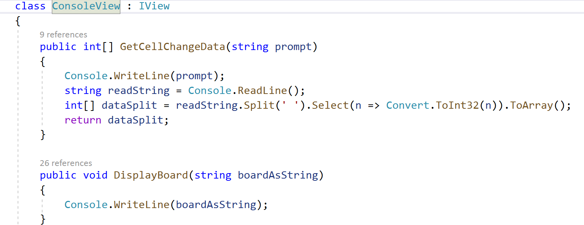
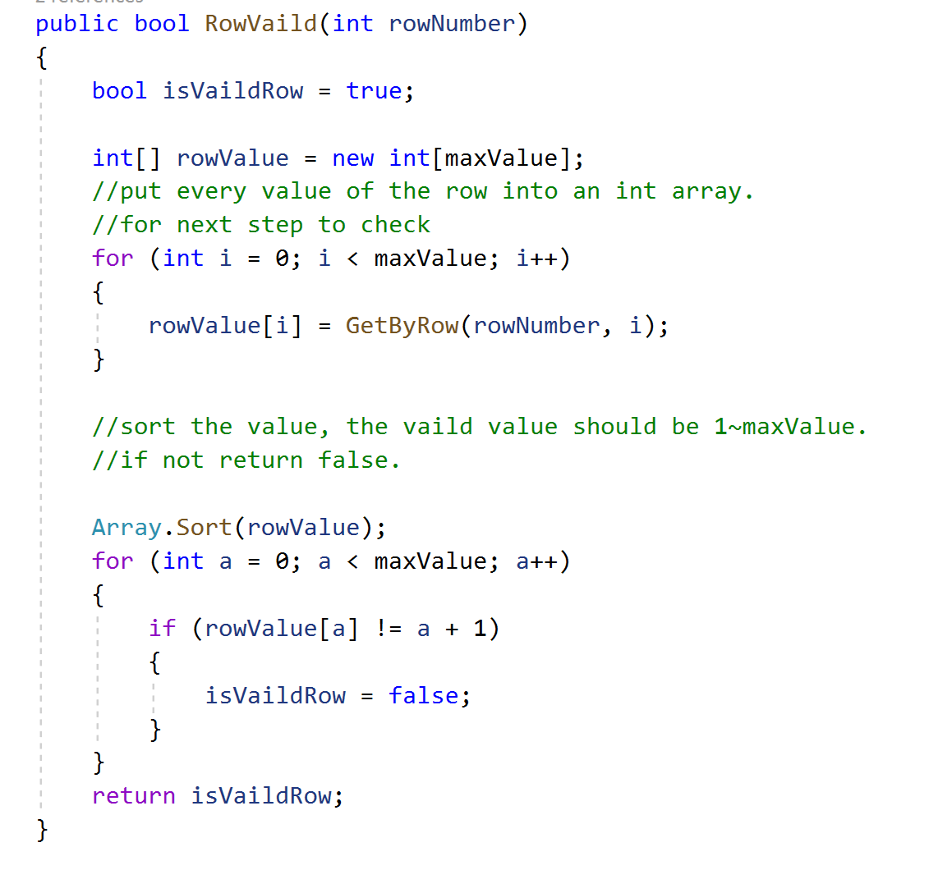
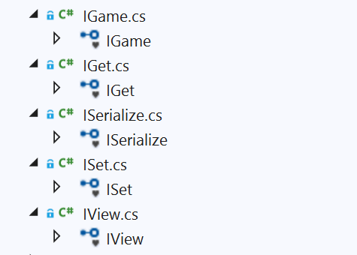
Theory One: Naming Conventions
5.1.3 Code Example
Example from <view> of class name, variable name, parameter names :
Example from <model> of class name, variable name, parameter names :
Example of Interface:

Slide 41
Theory One: Naming Conventions
5.1.4 Theoretical summary
Following the Naming Conventions in the process of completing this project has the following advantages:
Effectively avoid the occurrence of naming conflicts.
Reduce the work required to read and understand the source code.
Provide better understanding in case of code reuse after a long interval of time.
Enhance the aesthetic and professional appearance of work product.
Enable the use of automated refactoring or search and replace tools with minimal potential for error
5.1.5 How could I improve.
The names of some of the variables and parameters in the project should be clearer and more explicit.
Reduce the ambiguous naming.

Slide 42
Theory Two: Commenting Conventions
5.2.1 What is Commenting Conventions?
C# Coding conventions :
Place the comment on a separate line, not at the end of a line of code.
Begin comment text with an uppercase letter.
End comment text with a period.
Insert one space between the comment delimiter (//) and the comment text, as shown in the following example.
Do not create formatted blocks of asterisks around comments.
Ref : https://docs.microsoft.com/en-us/dotnet/csharp/programming-guide/inside-a-program/coding-conventions

Slide 43
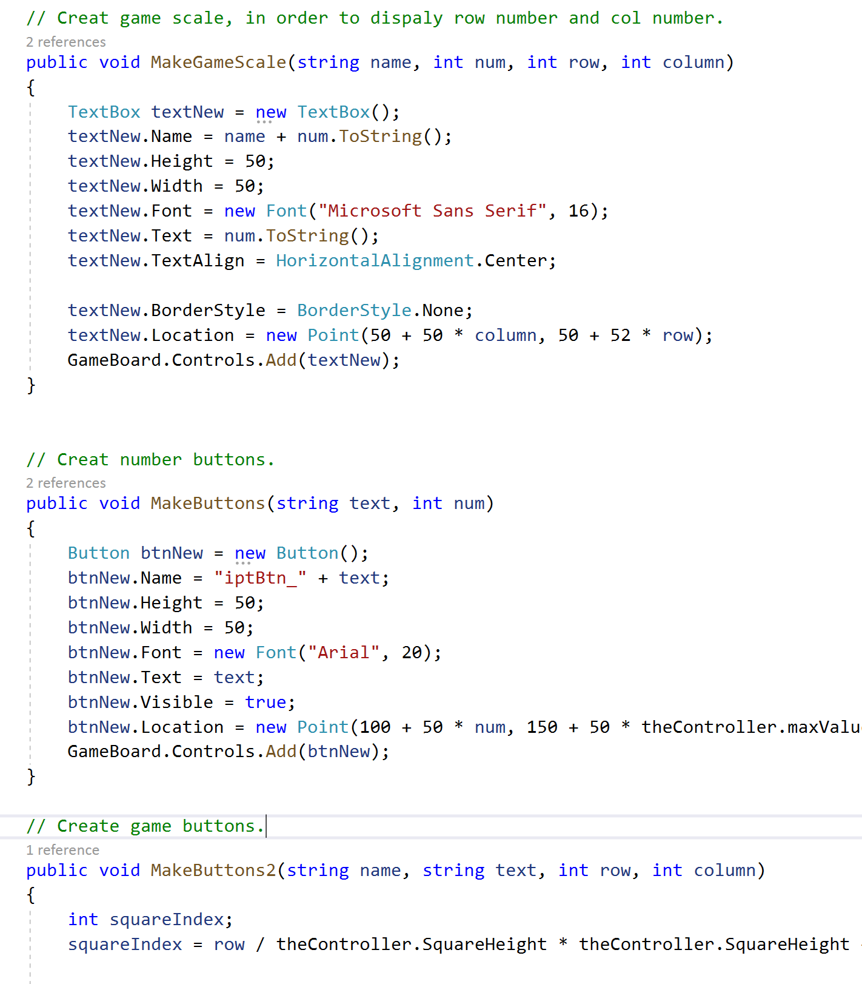
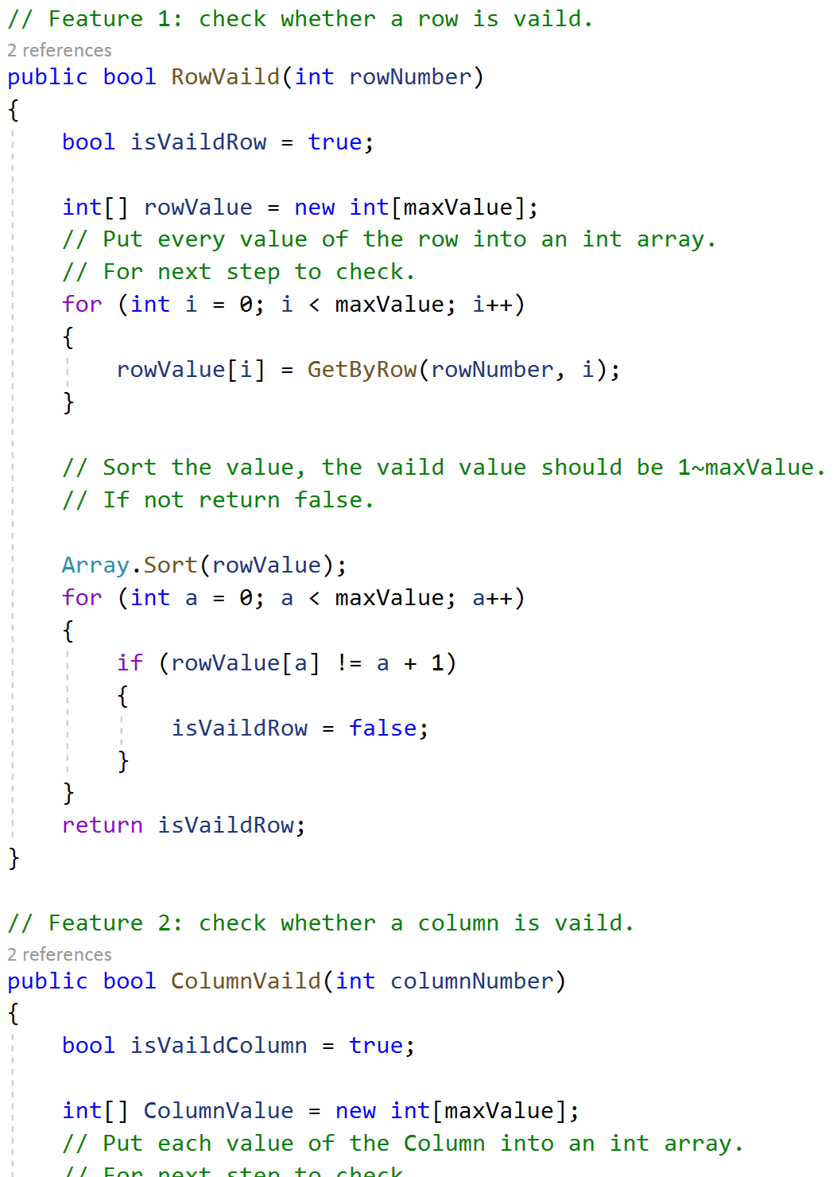
Theory Two: Commenting Conventions
5.2.2 What I have done & Code Example
Example from <view>:
Example from <model>:
Add comments to each function.
If the logic is complex, add a comment to explain.

Slide 44
Theory Two: Commenting Conventions
5.2.4 Theoretical summary
Comments are like memos in the programming process. Good comments must follow the Commenting Conventions. First, good comments make the program cleaner and easier to read.
Second, good comments can help programmers quickly understand program structure and function.
Finally, good comments facilitate late maintenance of the program.
5.2.5 How could I improve.

Slide 45
Q6. Produce and execute testing strategies at the systems level using a unit testing framework.

Slide 46
Q7. Debug and test programs to the systems level.

